Slide 1
Photographer Presentation
ART 254-01
Professor Livingston
Presenter: Sharon Nilsen

Slide 2
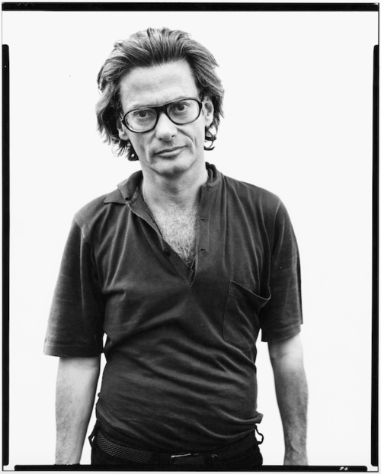
RICHARD AVEDON
1923-2004

Slide 3
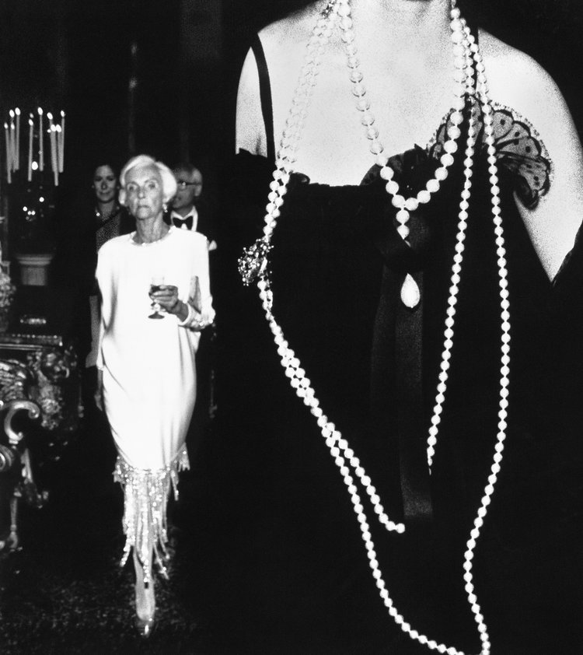
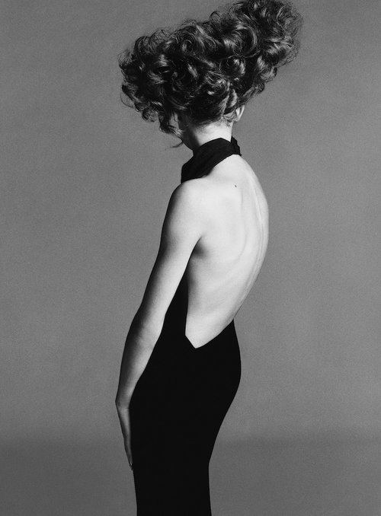
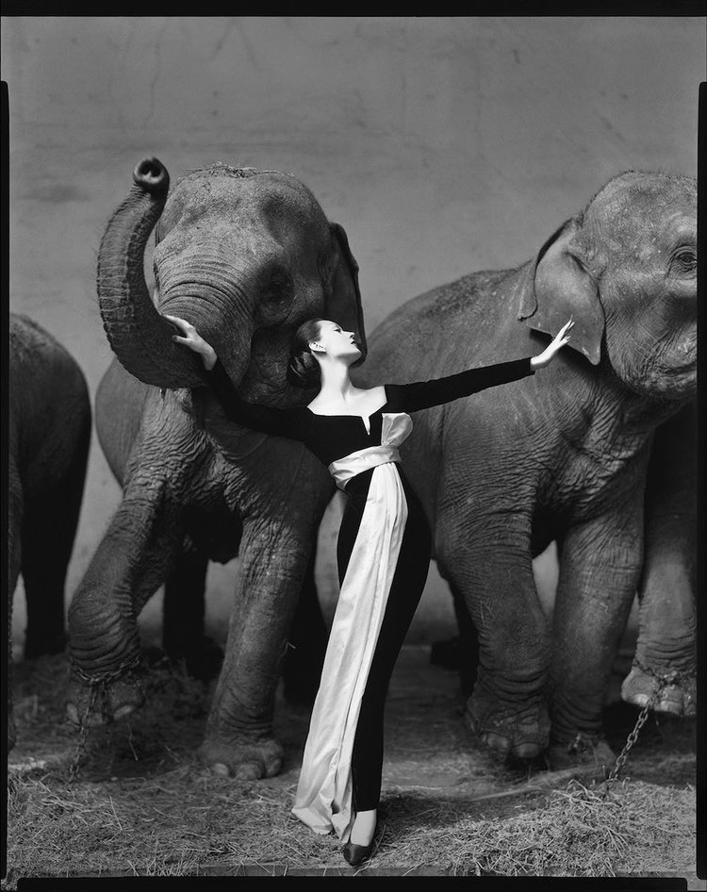
Jean Shrimpton, evening dress by Galitzine
Hair by Alexandre, Paris, August 1965
Jacqueline Delubac, Volpi Ball
Venice, Italy, August 31, 1991
Dovima with elephants
evening dress by Dior
Cirque d'Hiver, Paris, August 1955

Slide 4
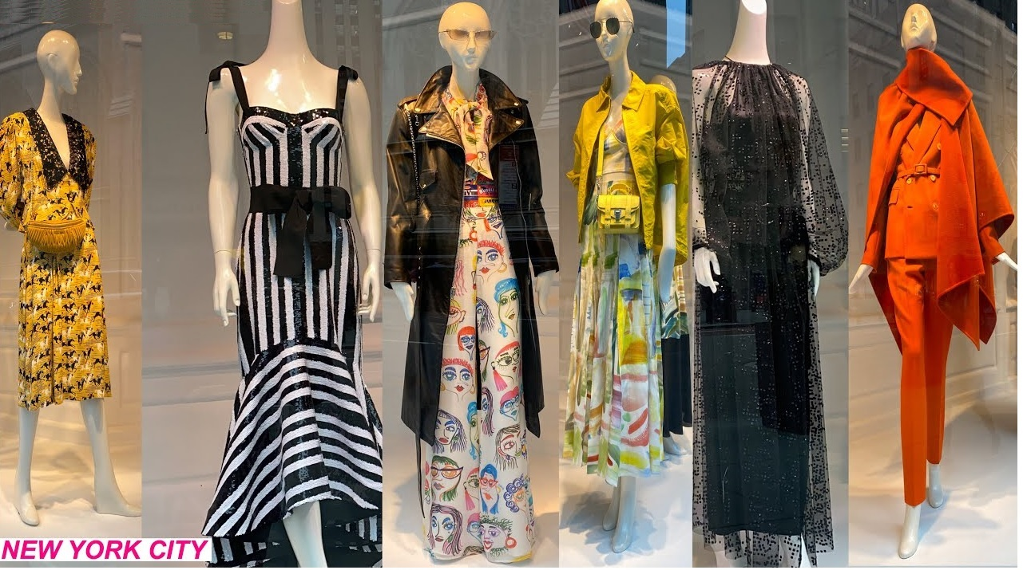

Slide 5
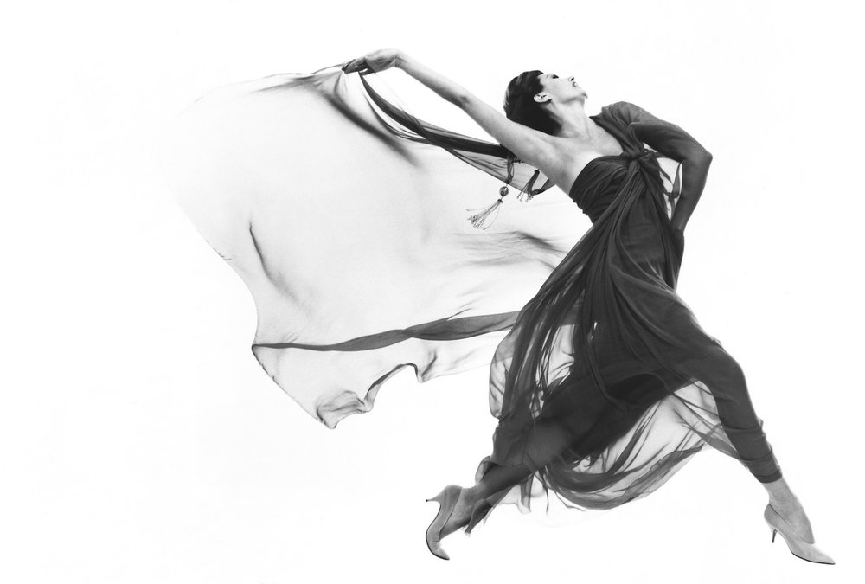
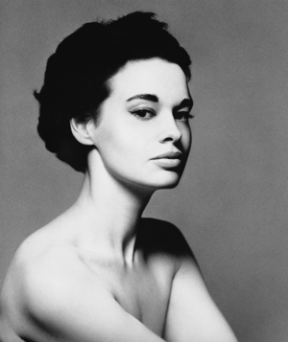
Gloria Vanderbilt, Dec. 17, 1953

Slide 6
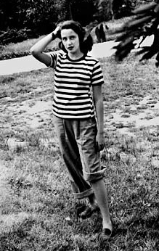
"Louise's beauty was the event of our family and the destruction of her life.
She was treated like there was no one inside her perfect
skin…” - Richard Avedon
Louise Avedon -
died at age 42 in a psychiatric hospital

Slide 7
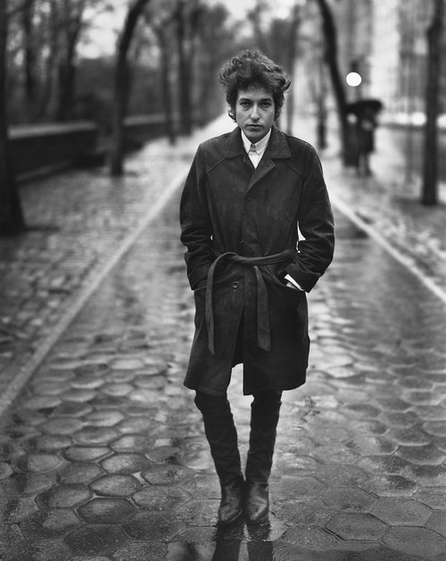
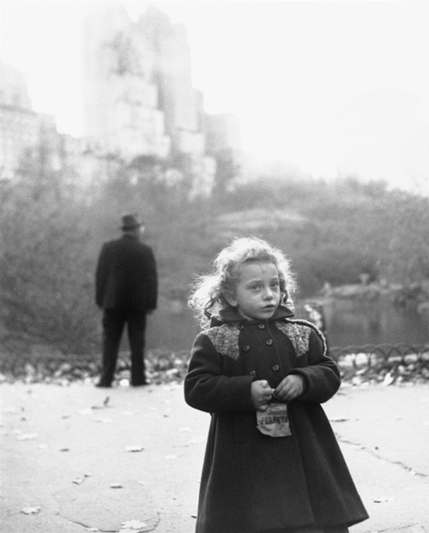
New York Life #11, Central Park, New York
November 17, 1949
Bob Dylan, singer, New York City February 10, 1965

Slide 8
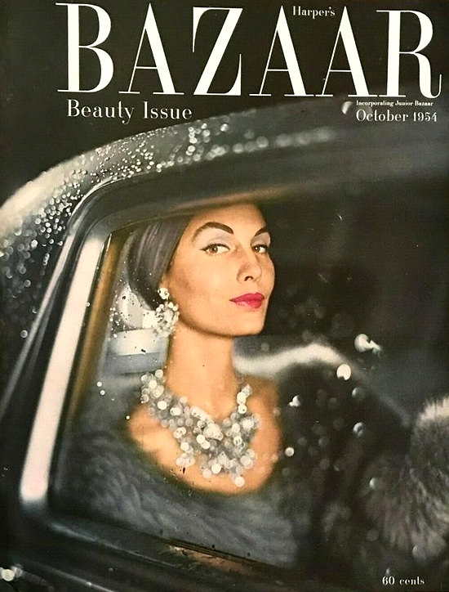
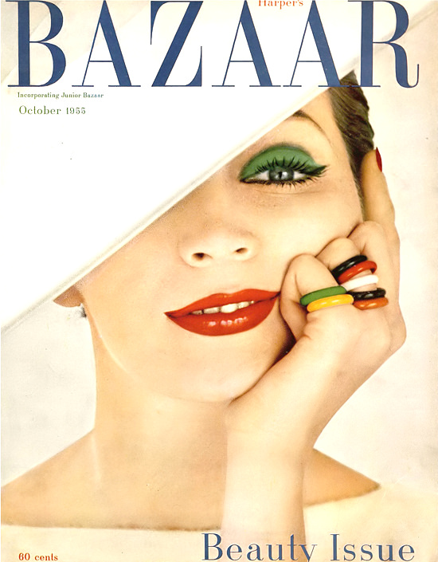

Slide 9
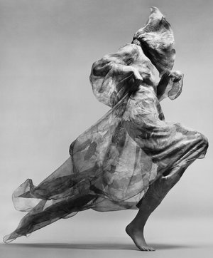
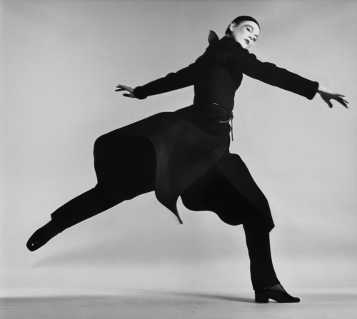
Ingrid Boulting
coat by Dior
Paris studio, January 1970
Veruschka, dress by Bill Blass
New York, January 4, 1967
Jean Shrimpton
evening dress by Cardin
Paris, January 1970

Slide 10
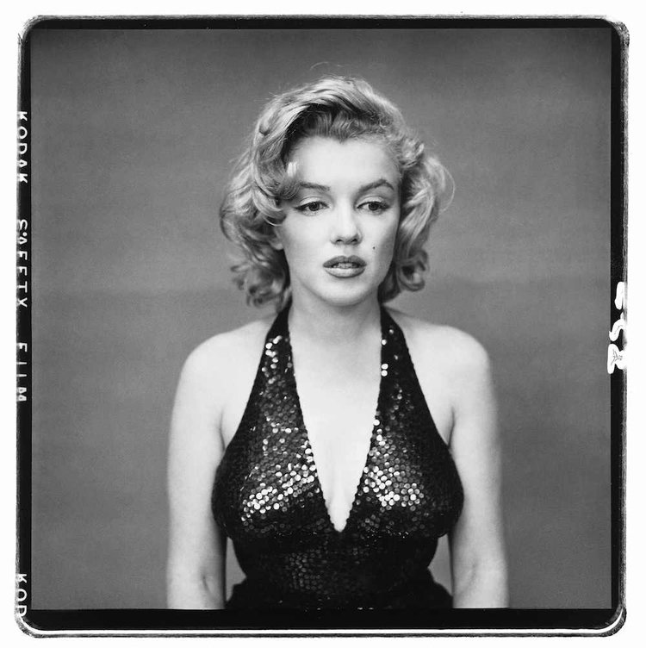
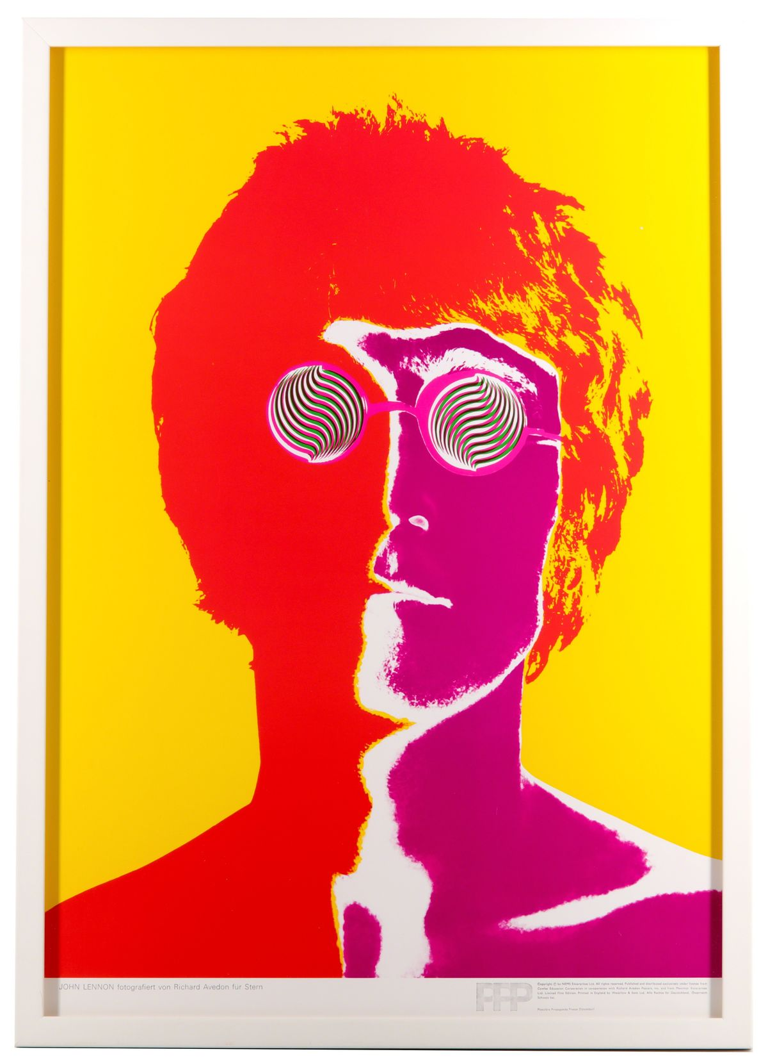
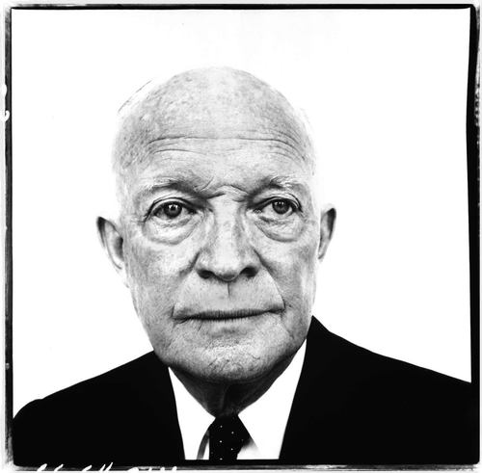
Marilyn Monroe
May 6, 1957
John Lennon
August 1967
Dwight D. Eisenhower
1960

Slide 11
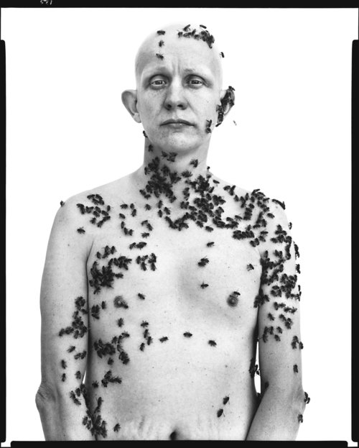
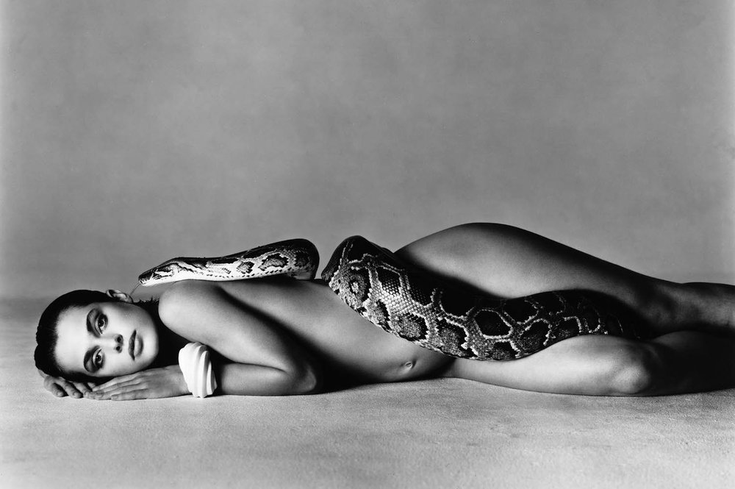
Nastassja Kinski, actress, Los Angeles, June 14, 1981
Ronald Fischer, beekeeper
Davis, California, May 9, 1981

