Slide 1
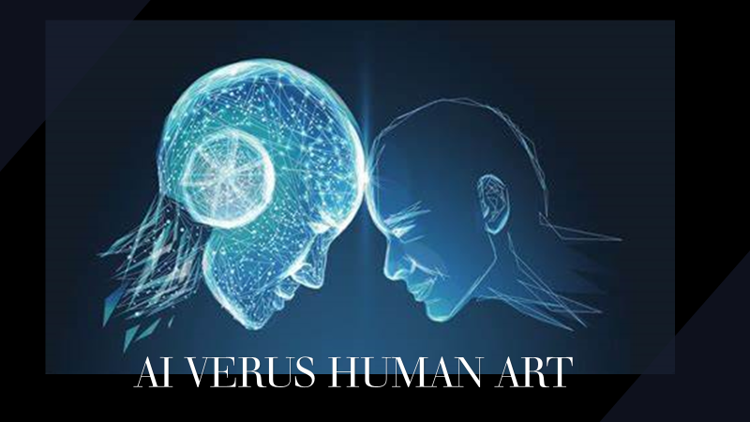

Slide 2
Introduction
AI’s IMPACT ON ART CULTURE
Art Redefined
Creativity Redefined
“Democratizes”
Art
Faster
Cheaper
Job Loss to Human Artists
Copyright
Concerns

Slide 3
Introduction
The Problem
AI Annual Growth Rate: 39%
60 B to 422 B by 2028
Graphic Design Job Outlook -4% Growth to 2029
Chat-GPT
DALL-E
AI Popularity

Slide 4
Rationale
For Study
Learn AI’s
Appeal &
How to Coexist
This Study:
Decoding
Distinguishing
Art’s Message
Missing In
Research:
Visual Art’s
Message
Artists Need Insight

Slide 5
Purpose
Patterns that Exist about Preference
Relationships between background of audience and evaluation
Opinions about AI art

Slide 6
Research Question:
“Are there measurable differences in how people interpret and distinguish AI and human art?”
Context
Preferences
Art Origin

Slide 7
Literature Review
Previous Research
Opinion about AI Art
As Art
Difficulty of Identifying AI Art
No Research on the Decoding of Visual Art
“Visual art is a medium with a message.”

Slide 8
Literature Review
Encoding-Decoding Theory
Stuart Hall
CODES
Dominant
Reception
Analysis
Oppositional
Negotiated

Slide 9
Literature Review
Message
Context
Reception
Or Coding

Slide 10
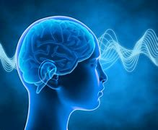
Literature Review
Schema Theory- Frederic Bartlett
“Bits of info.”
Hair, 4 Legs, & Tail
See Cow- “Horse”
“Horse”
“We understand the world by constructing models of it in our minds.“

Slide 11
Literature Review
Schema Theory in AI Art Research
This Study’s Application
Reception Analysis Theory
(Hong, 2018)
Schema Theory
Hall
“Knowledge of origin” affects preference
Bartlett

Slide 12
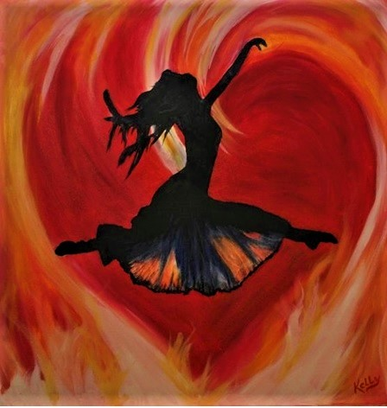
Method
Survey -Pure Research
HUMAN ART Kelly Carroll
“Leaping Freedom Heart of Fire”
AI ART
DALLE

Slide 13
METHOD
CA- (stands for)
Communication/Visual
Arts Education
Target Sample
Current SHC Students
& Staff
WITHOUT CA
WITH CA

Slide 14
Participants
45:55 Male to Female
Race:
60% White
26% Black 53 Participants
12% Other
Age
17 to 39

Slide 15
Most Surprising Result
Education/Ability to Identify
2- YRS/ 60%
3 YRS/ 27%
4 + YRS/0%
???
Not Expected

Slide 16
Results
Art Type Did Not Change Opinion
Schemas Influenced Preference
Unfavorable opinion toward AI’s impact on Culture
SPSS- Chi-2
Thematic
Analysis
No Significant Difference in Decoding
More Education Did Not Help Identify Art

Slide 17
Schema Preferences
Symbolism
Technique
Focused
No Boundaries
Precision
Heart
Focused
Imperfection
Woman
Focused

Slide 18
EVALUATION
More Thematic Analysis
More Thematic Analysis
MoMoMore
EVALUATION
EVALUATION
M
Good Mix of Data on Surveys
SPSS and Testing Correct
V
SPSS And Testing Correct
More Cell Proportions

Slide 19
“TAKE AWAYS”
Conclusion
KNOW AUDIENCE
CONNECT WITH AUDIENCE
VIEW AI IN A BETTER LIGHT

Slide 20
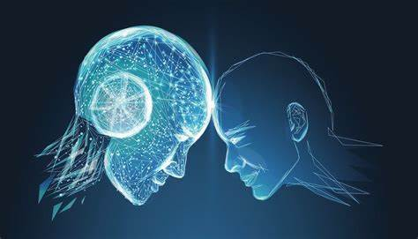
24 - 29
THANK YOU!

